Slide 1
Problems of scale when analyzing high throughput sequencing datasets (Computational paradigms in molecular biology revisited)
Greg Gloor
ggloor@uwo.ca
@gbgloor
@gbgloor.bluesky.social

Slide 2

The goal
Given a high throughput sequencing dataset:
Identify what drives the difference between groups
Ideally analyses are internally consistent
Ideally analyses are robust and reproducible
Notes:
Many more fragments than we can count

Slide 3
How we get our data
Reality
Measurement

Slide 4
Why is this hard (part 1)?
Lots of moving parts
Something can:
==
∆ abundance
∆ occurrence
Notes:
Many more fragments than we can count

Slide 5
Why is this hard (part 2)
We don’t measure the moving parts directly
Gloor et al Front. Micro. 2017

Slide 6
We have problems
Sequencing data are probabilistic random samples
Almost always point estimates or worse – averages
Single-cell and UMIs can help here but …
Sequencing data are compositions
everything correlates with everything
the levels are confounded if the bacterial load (or the total amount of mRNA) differs between samples
We will call this ‘scale’
our conclusions change when we include or exclude different sets of features
(Pearson 1896 Proceedings of the Royal Society of London 60, 489: Aitchison 1986 The Statistical Analysis of Compositional Data: Lovell 2015 PLoS Comput Bio,11:e1004075 )

Slide 7
We have problems
Sequencing data are high-dimensional
Therefore statistical analyses can be wildly optimistic
Analyses can converge on an exactly wrong answer
Sequencing data are sparse
Therefore we need to estimate many of our values
Most of us are, at best, begrudgingly aware of the problems

Slide 8
Data as counts
Example 100 random sample sets
range=1800-2200
range= 8000-12000
range=450-550
🐯
🐞
👽
Gloor et al Front. Micro. 2017

Slide 9
As delivered by sequencing
Constant sum of 1000
Constant sum operations:
Count normalization
RLE, TMM, CSS …
Rarefaction
Proportion
percentage, relative abundance
CLR
Sequencing
Simplex: one fewer dimensions than variables
Problems remain regardless of dimension
More dimensions make it “look OK” but it’s not
Gloor et al Front. Micro. 2017

Slide 10
Normalization is no help at all
Once data are on the simplex, they cannot be removed easily

Slide 11
Log-ratios for CoDa
Count
Sequencing
Simplex
27
853
66
740
112
216
clr(x) = [ log(x₁/g_{X}), log(x₂/g_{X}), … log(x_{D}/g_{X}) ]
X = [ x₁, x₂, … x_{D} ], g_{X} = geometric mean of X
As we will see there is an important hidden assumption in g_{X}!
Aitchison 1986. Stat. Anal. Comp Data
Pawlowsky-Glahn, 2015. Mod. Anal. CoDa
Notes:
Scale dependence - hence ‘normalization’
Correlation and covariation are unreliable
Addition and subtraction are not useful operations
Subsetting and aggregating are problematic
Sparse data is an issue

Slide 12
ALDEx2: probabilistic CoDa
Group 1 Group 2
Generate posterior estimates of the data consistent with the observed data and the chosen prior(s)
Dirichlet instances
lr transform instances
Calculate test values on each instance
Correct for FDR
Report the expected value of each test for all instances
Dramatically reduces false positives with little or no loss of sensitivity for essentially any seq*omics dataset
Fernandes, et al. 2013. PLoS ONE
Fernandes, et al. 2014. Microbiome
Thorsen, Microbiome 2016
Notes:
Many more fragments than we can count

Slide 13
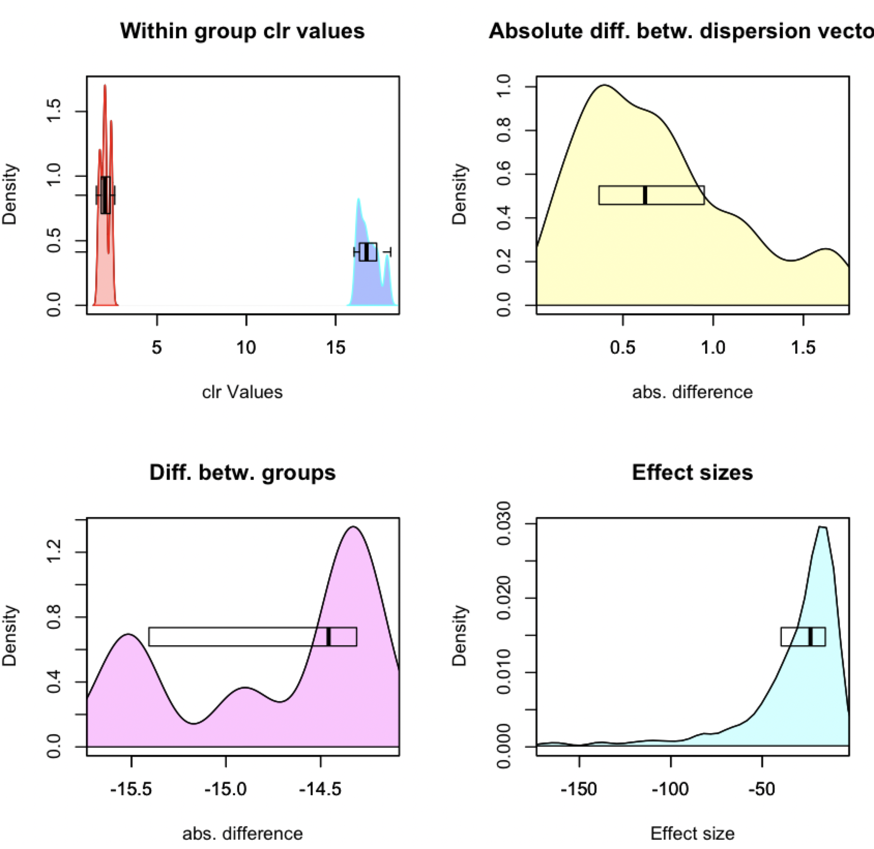
ALDEx2 under the hood
CLR Distribution
Dispersion
aldex.plotFeature()
Difference
Effect

Slide 14
Bad data
Assumptions of all tools and normalizations
Very few DA features
DA is symmetric or at least stochastic
Equal underlying environmental abundance
High quality transcriptomes
Bad data
Many DA features
Asymmetric data
Different environment sizes
Everything else

Slide 15

Dark underbelly of HTS
Domain-specific tools
Why not treat all HTS data the same?
Dataset-specific workflows/analyses
Why use multiple approaches?
Instability in results
Why does sub-setting change outcomes?
Correlation!
Is there a general solution?
General lack of robustness

Slide 16


Our data in reality
Reality
Measurement

Slide 17
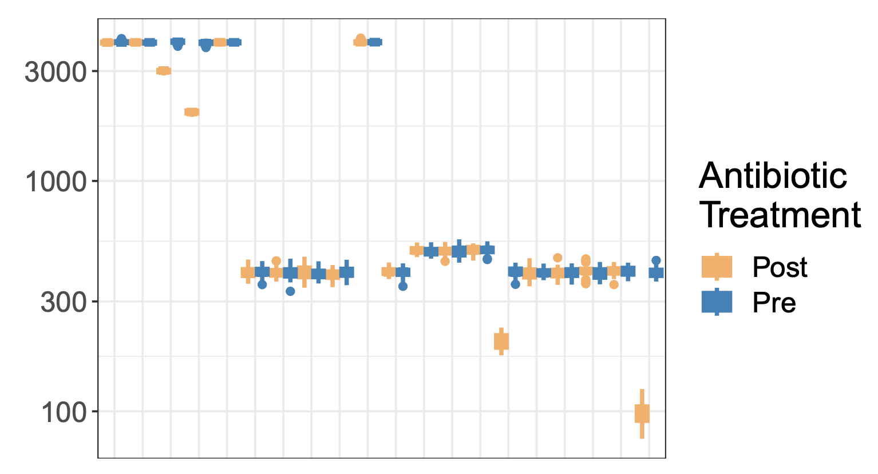
Drivers
‘Bad’ HTS data is shockingly easy to generate
Model chemostat experiment
Mis-estimation of scale causes issues for compositional systems
Unacknowledged bias in specifying scale causes commonly observed analysis artefacts

Slide 18
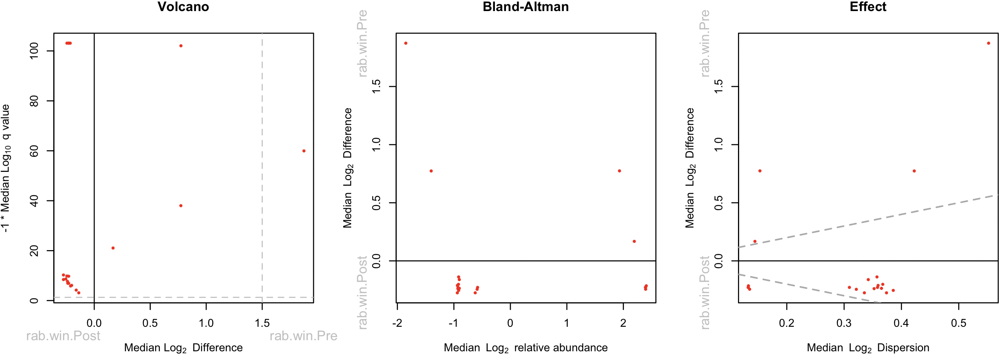
Plot your data

Slide 19
Diagnosing bad data
Too many things ‘significant’
Something must be invariant
q-score is unrealistic
Mismatch between model and test
Too much ‘power’ for sample size
No real variation
Many parts have 0 variance
Asymmetry
Few features on the line of no difference
Even ’good data’ can be actually bad!

Slide 20
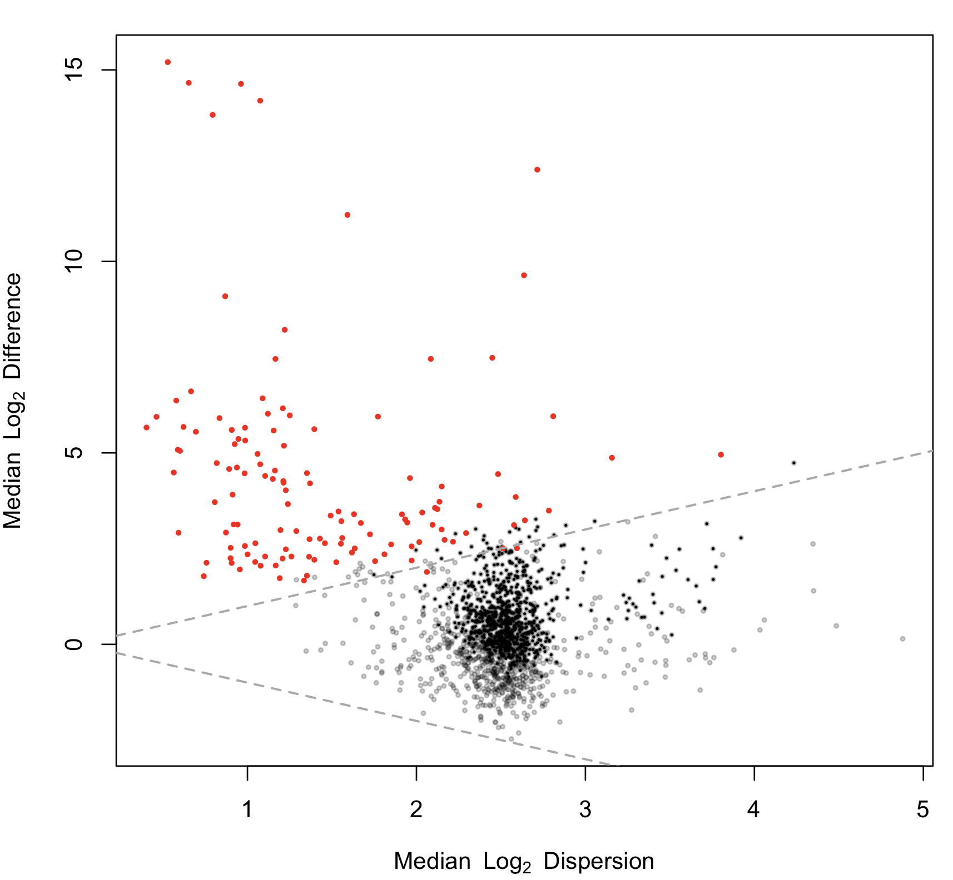
selex
‘Bad’ HTS data is shockingly easy to generate
Uni-directional change
Standard of truth

Slide 21
Meta-transcriptome
‘Bad’ HTS data is shockingly easy to generate
BV v H metatranscriptome dataset
Scale misspecification at play here
H / BV bacterial load ~ 1/10 – 1/100
- bulk scale ~8X
- housekeeping scale ~1.15X

Slide 22
Yeast transcriptome
Highly replicated yeast t’scome
>2/3 transcripts ‘significant’
We apply a 1.4-fold cutoff
3.1% transcripts significant

Slide 23
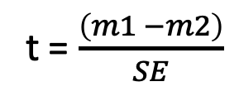
Dispersion vs. count
t = $\frac{\left(m1 −m2\right)}{SE}$
2 ways to get a high t and low p-value
1 - ?
2 - ?

Slide 24
Dispersion vs. count
t = $\frac{\left(m1 −m2\right)}{SE}$
2 ways to get a high t and low p-value
1 – big difference
2 - low SE (variance)
Which is most likely to be useful and correct?

Slide 25
Formally
The data table is a composition containing only relative data: Y∥
Y∥ is a D x N matrix
We want to know something about the environment: W
W=W∥ W⟂
W is a D x N matrix
Y∥_{dn} ≅ W∥_{dn}
Is a realistic estimate of W hopeless?

Slide 26
Enter Scale (Silverman,Nixon)
Data are normalized to make samples commensurate
Normalizations try to find latent information
Always assume most parts are invariant …
Normalizations are ratios (r)
Y^{∥(r)}_{dn}= Y∥_{dn} / 𝑓(Y∥)
True for RPKM, TPM, proportion, RLE, TMM, CLR, ILR, …
The CLR can be interpreted as a scale
CLR(Y∥) = log₂(Y∥_{dn}) – log₂(G(Y∥_{.n})) = log₂( Y∥_{dn} * 1/G(Y∥_{.n}) )
1/G(Y∥_{.n}) ≅ W⟂_{.n}
CLR thus resembles: log(W) = log(W∥) + log(W^{⟂)}
Silverman/Nixon showed that these were equivalent
and that this equivalence was useful

Slide 27
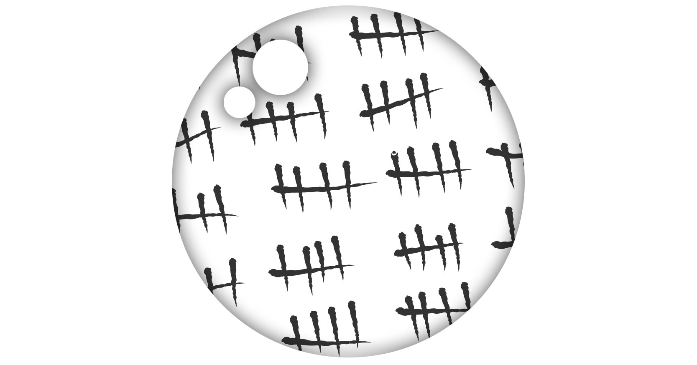
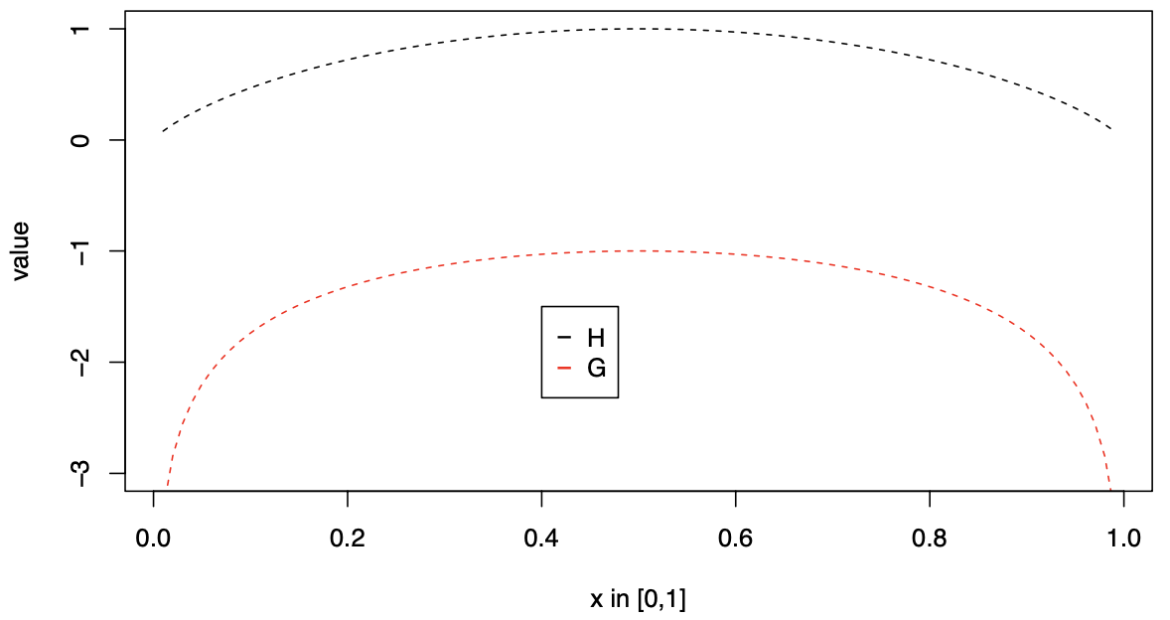
What is scale?
Known counts
Data from cell counting
Data from spike-in controls (but …)
Data from abundance measures
…
Information
log₂(1/G(Y∥_{.n})) = -log₂(G(Y∥_{.n})) = h₂(Y∥_{.n})
Expected Information (Shannon)
log₂(G(Y∥_{.n})) ≅ H₂(Y∥_{.n}) + C + 𝛖
Substitutable!
Entropy interpreted as volume or size in QIT

Slide 28
CLR(Y∥) is a poor approximation of W
Both Y∥_{dn} and G(Y∥_{.n}) are point estimates
All other normalizations less interpretable
Nixon/Silverman show that CoDa/ sequencing is PID and that a full posterior model has less bias
From Gustafson 2015

Slide 29
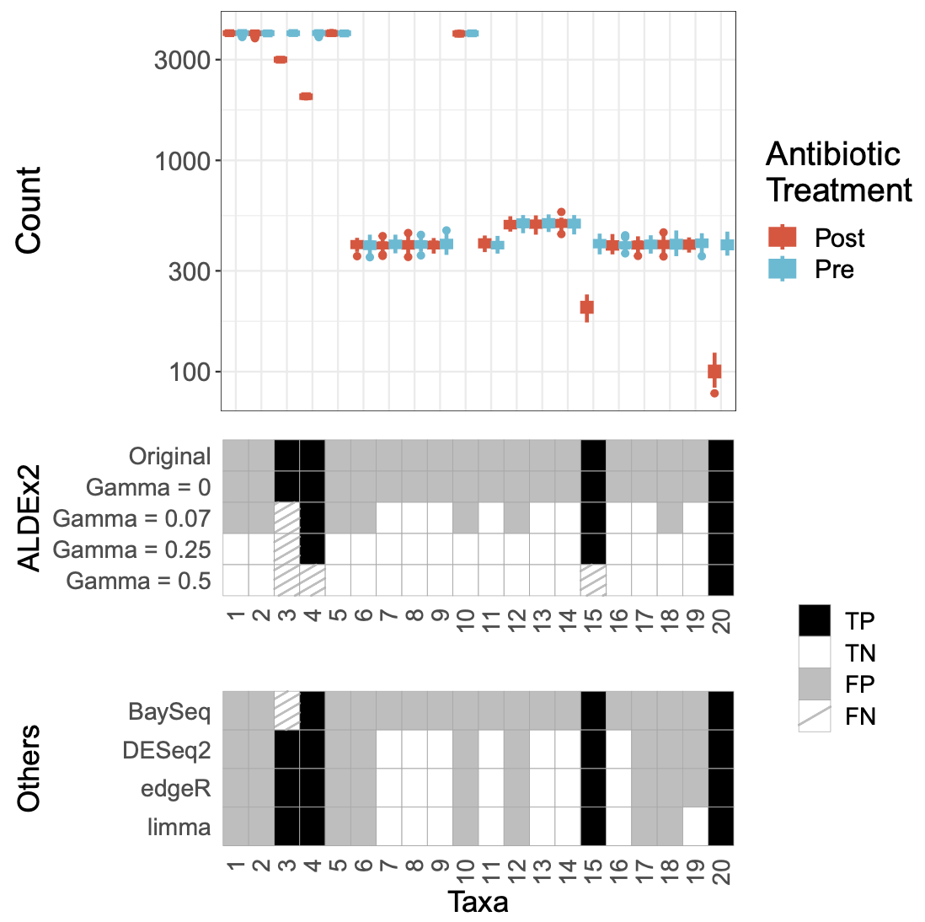
Simulated bioreactor
Simulated bioreactor data
High FP rate across the board
Data are asymmetric
Adding scale removes FP

Slide 30
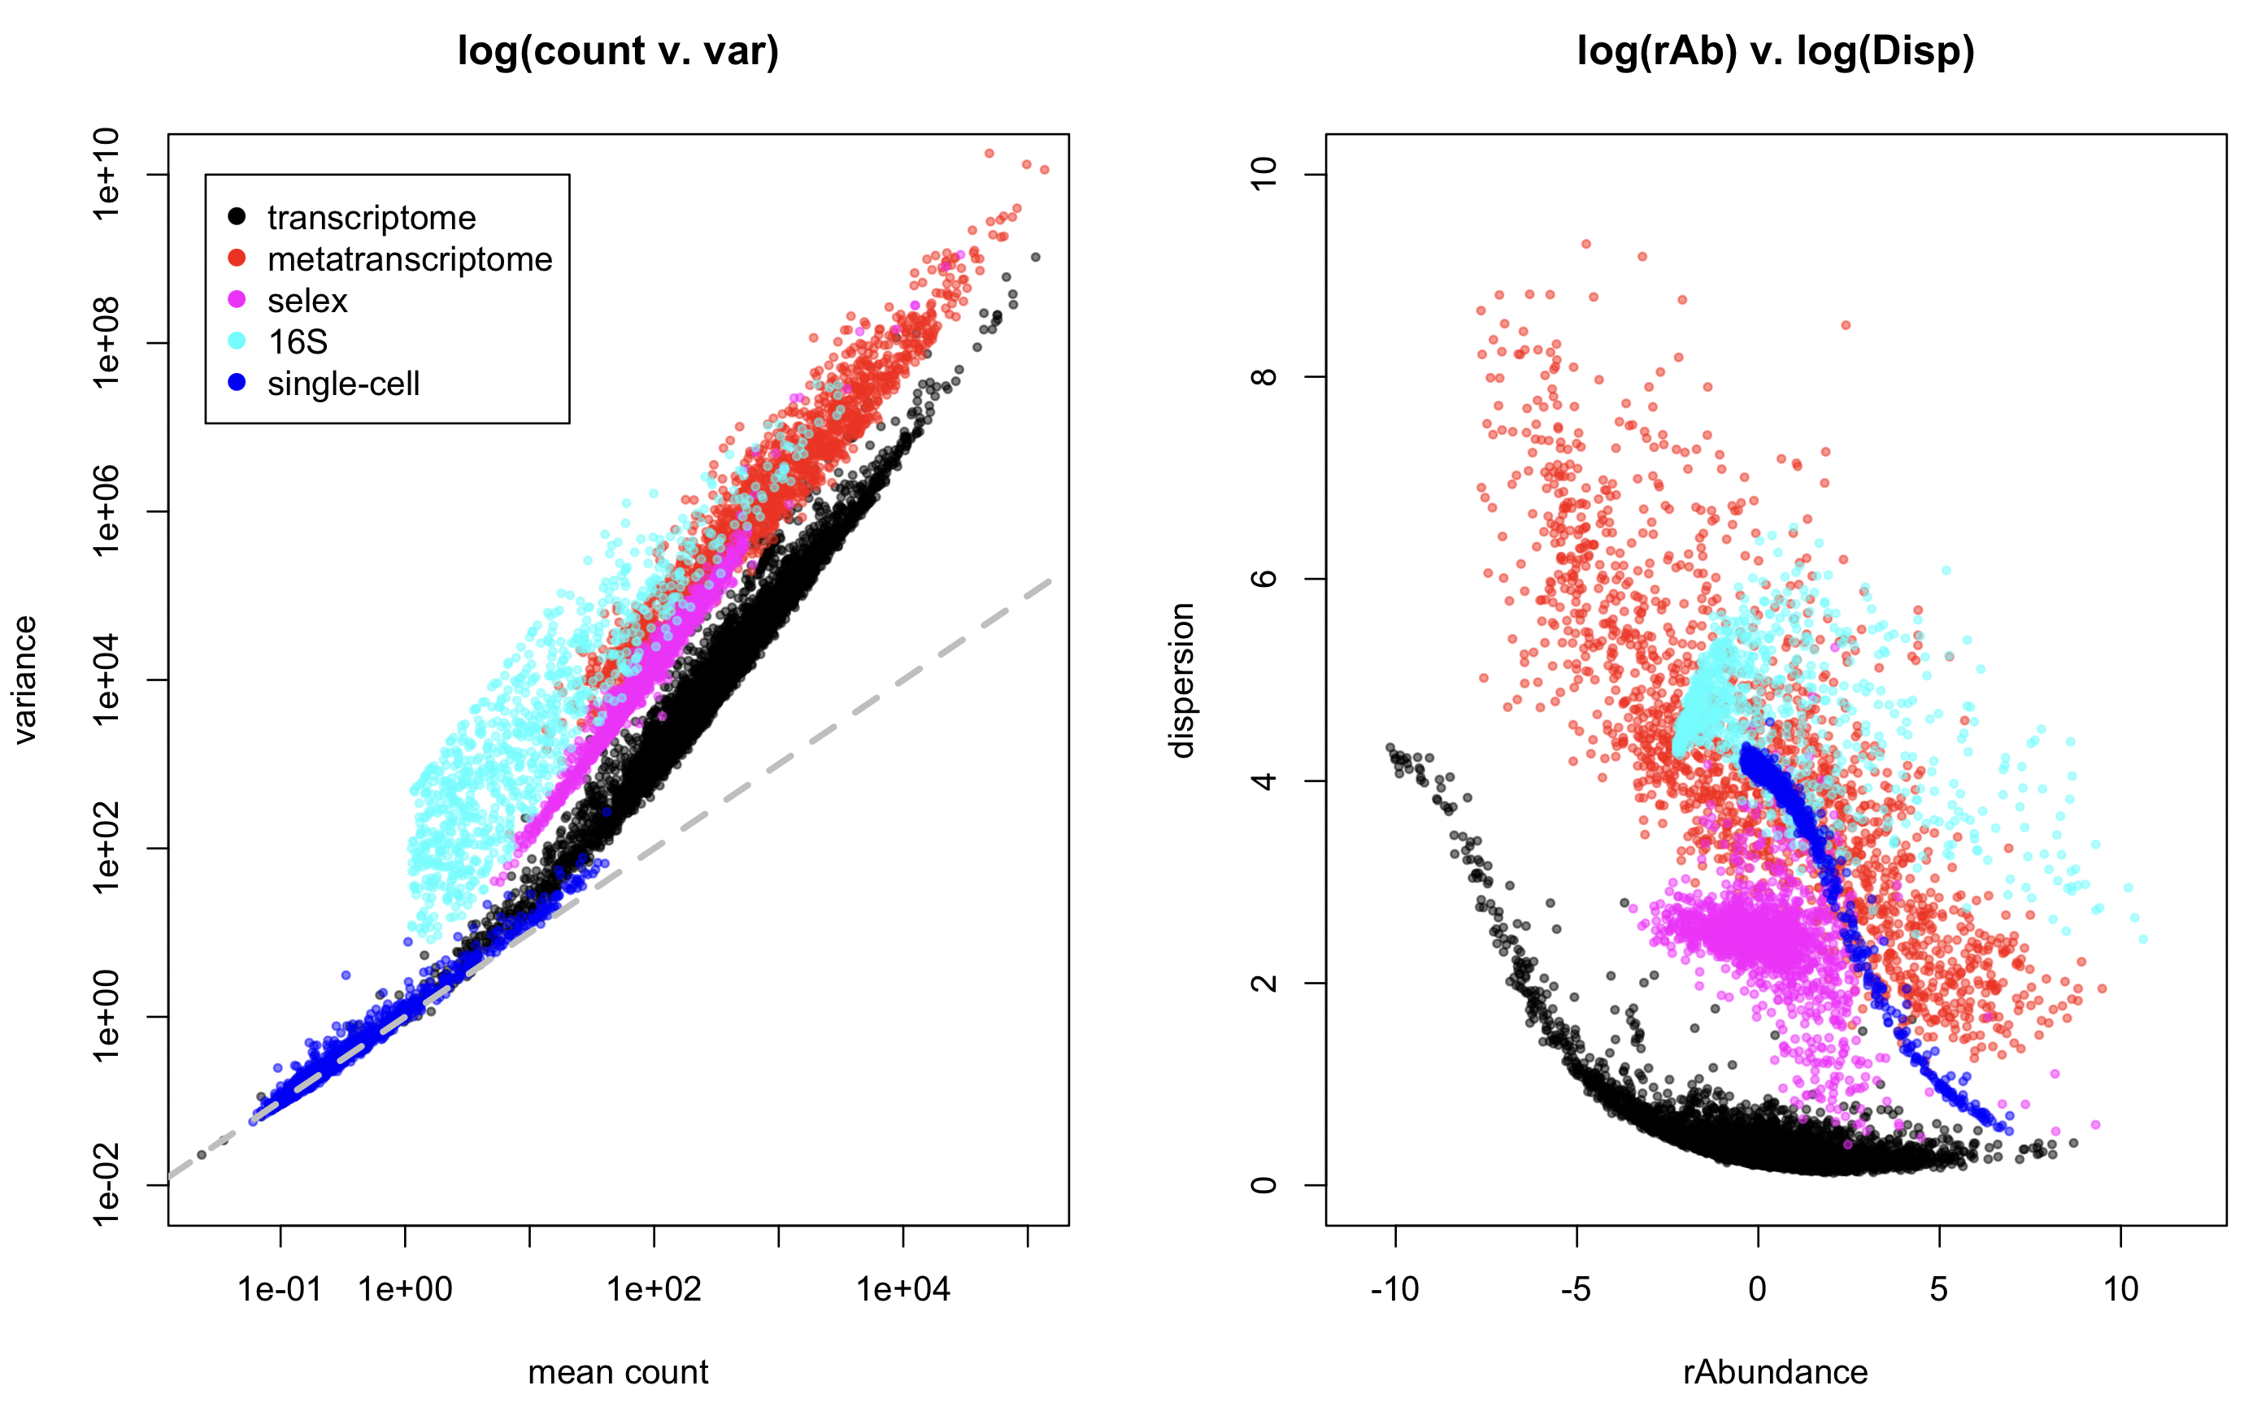
All count data are NB, but …

Slide 31
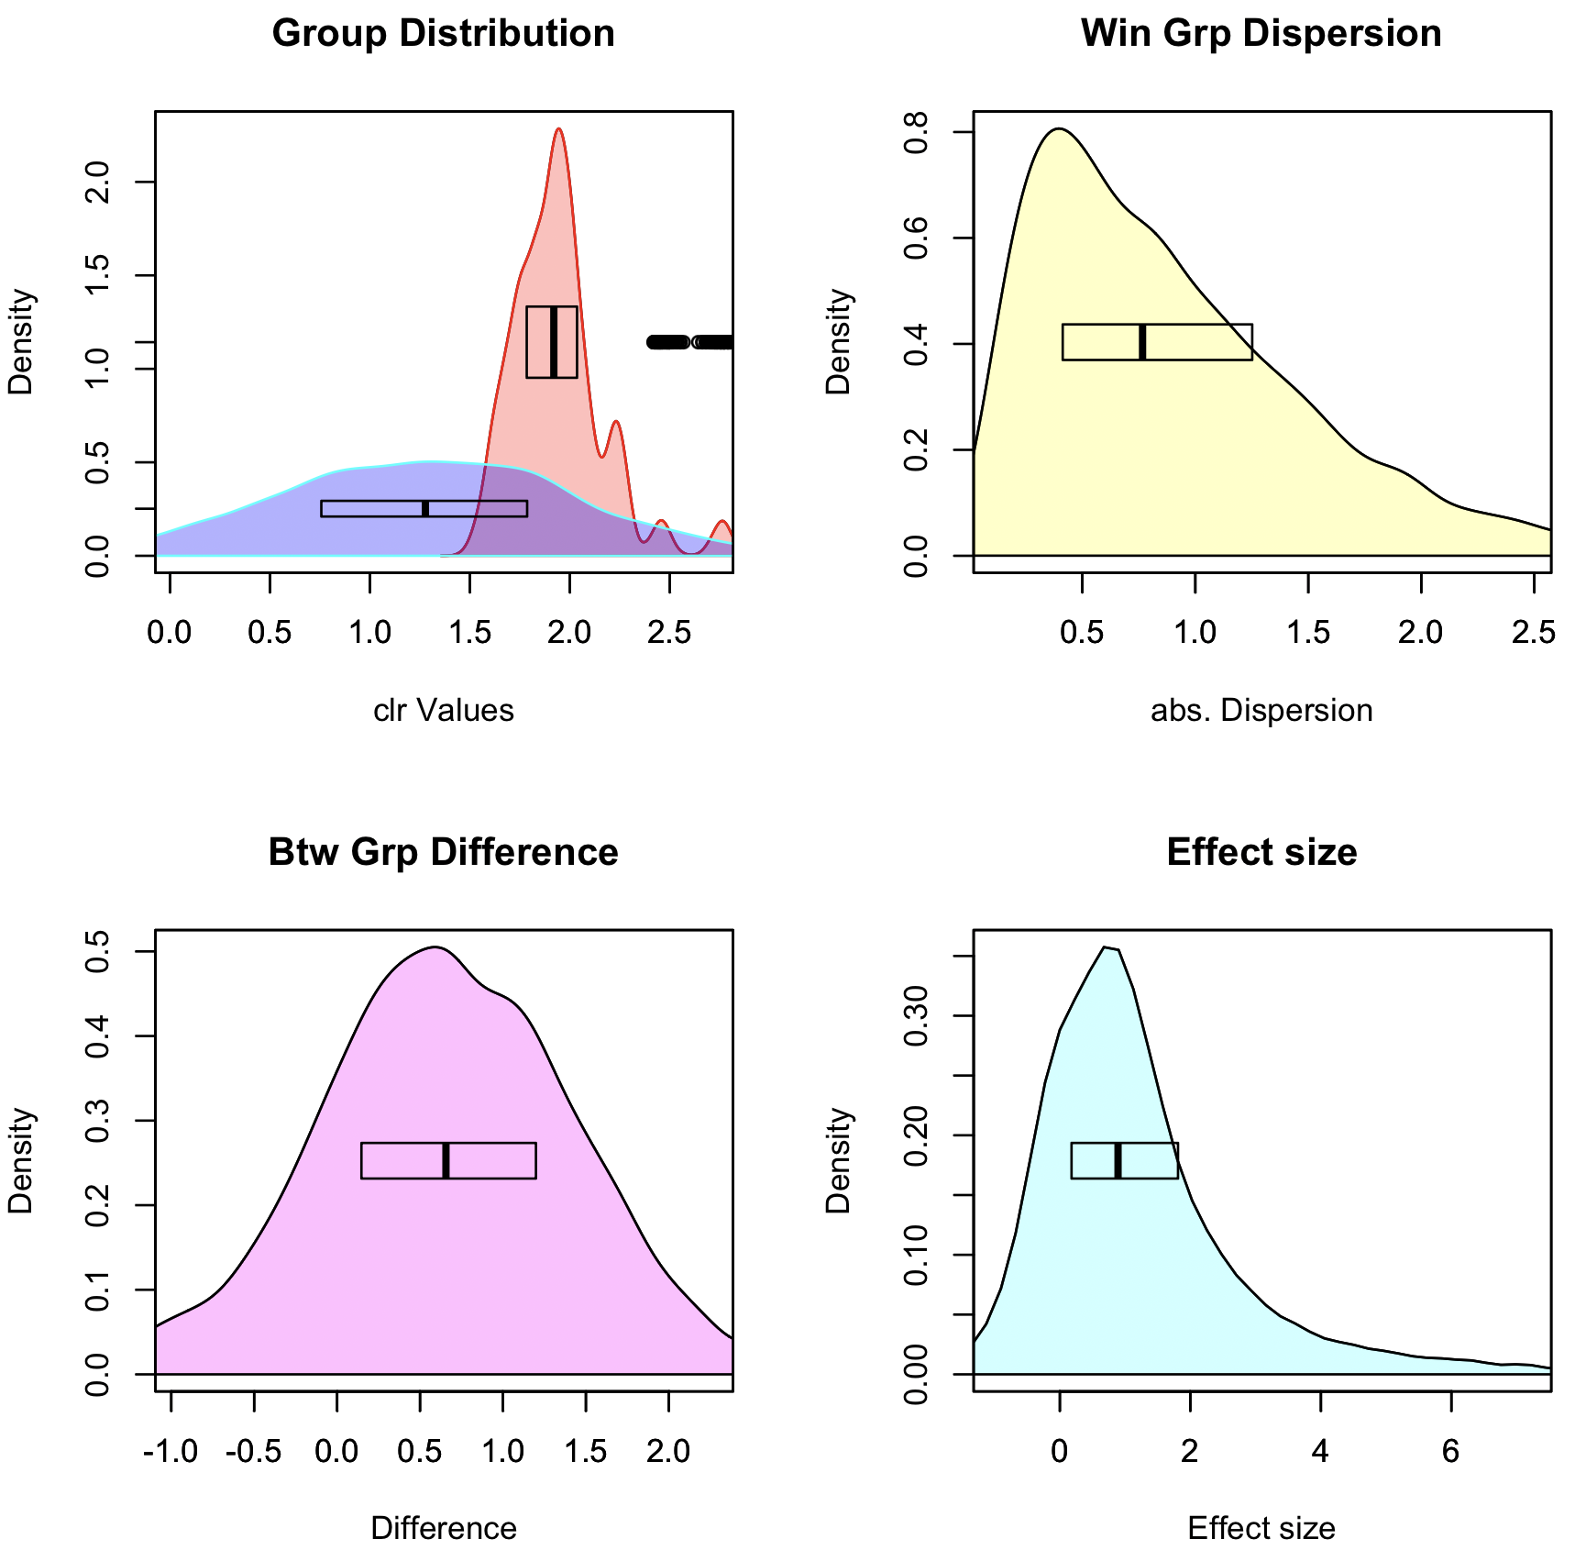
Graphical intuition
Posterior distributions:
rab.A, rab.B
Pooled dispersion: diff.win
Pooled difference: diff.btw
Pooled Effect: effect

Slide 32
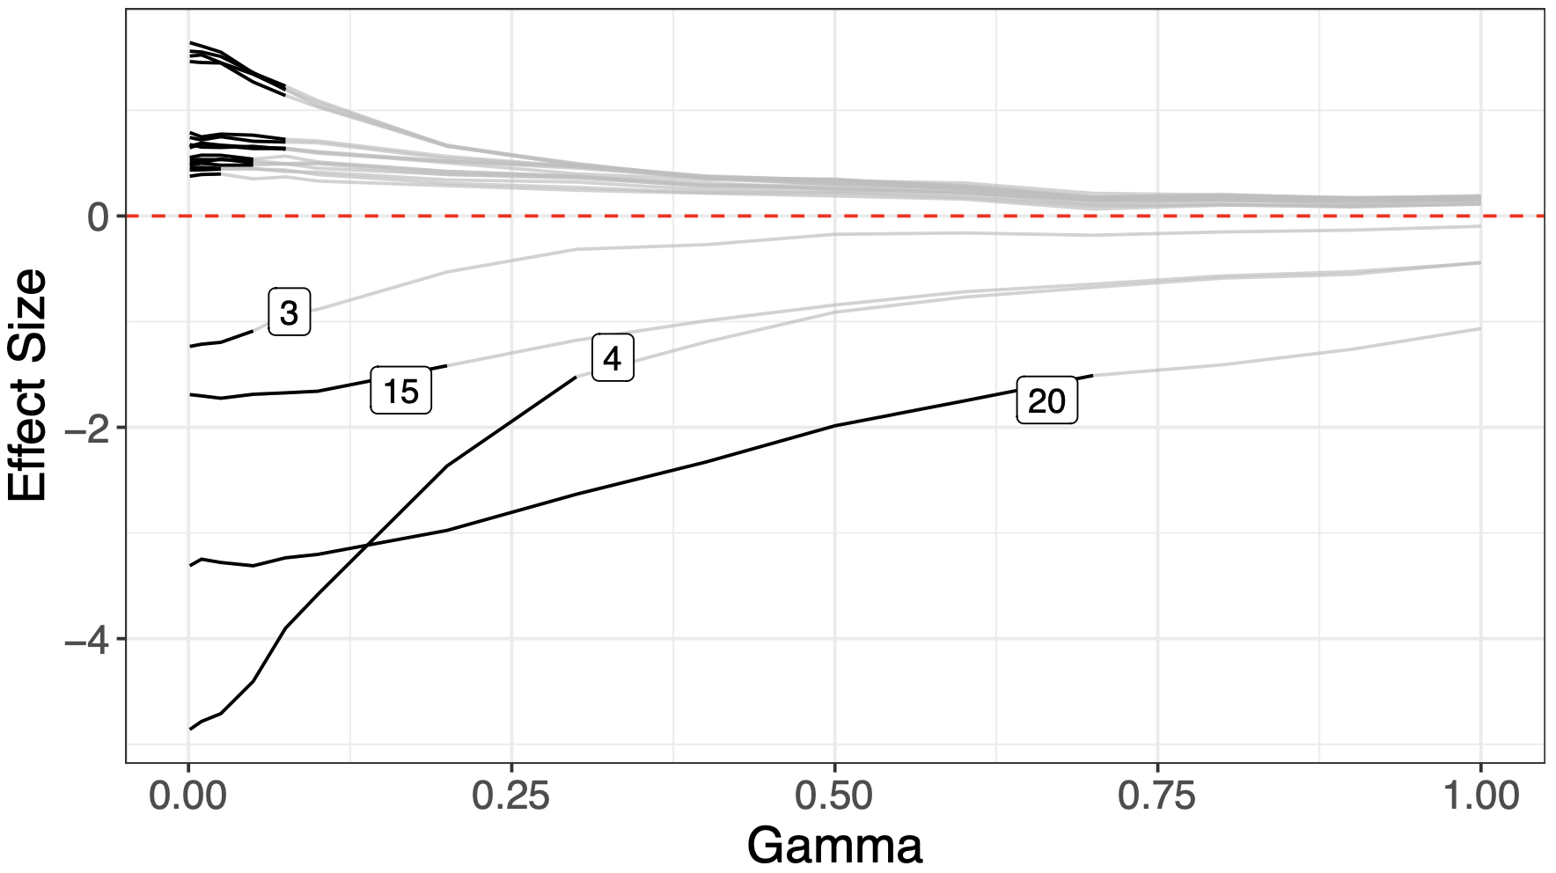
Bioreactor sensitivity analysis
Simulated bioreactor data
High FP rate across the board
Data are asymmetric
Adding scale removes FP
Sensitivity analysis can help find scale settings

Slide 33
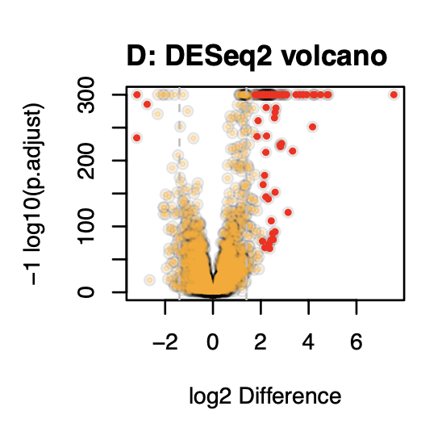
Unacknowledged bias in practice
Observation that too much data is counterproductive (Schurch)
In a highly replicated RNA-seq experiment over 70% of transcripts are DA
Biologically implausible
Breaks assumption of normalization (RLE)
Dual cutoff solution
Jussi (RPE vs HepG2)

Slide 34
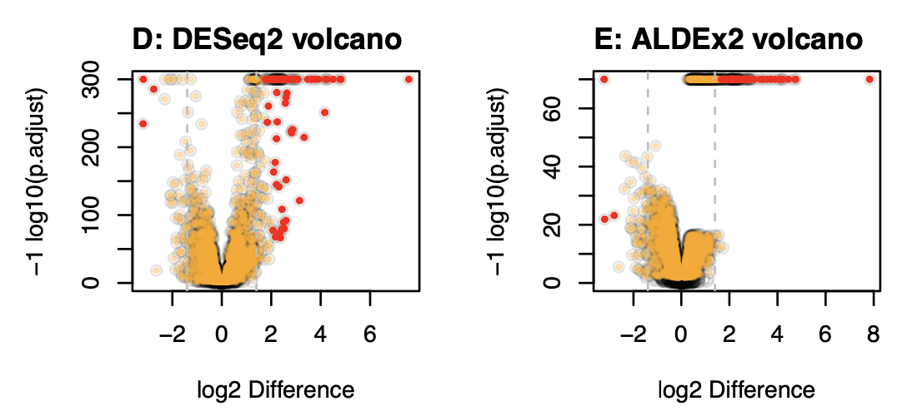
Overpowering is normalization independent
Jussi (RPE vs HepG2)

Slide 35
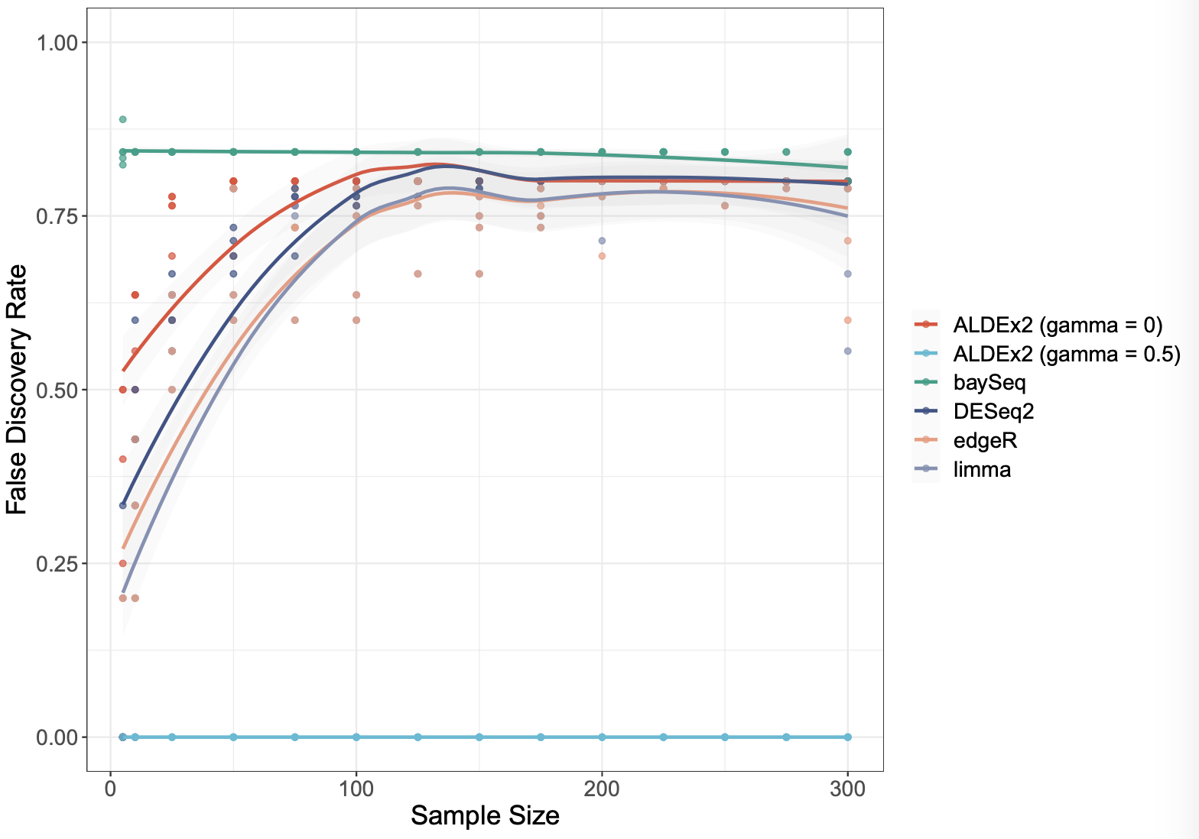
Scale keeps sensitivity, removes overpowering
Simulated bioreactor data
High FP rate across the board
Data are asymmetric
Adding scale removes FP
Sensitivity analysis can help find scale settings
Increasing sample size makes problem worse for all tools but the scaled model

Slide 36
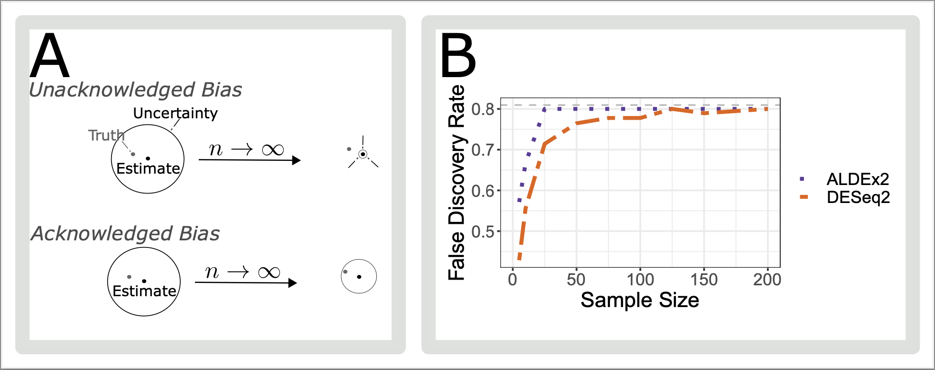
Because - unacknowledged bias

Slide 37
Summary
HTS data are partially identifiable:
Scale is assumed, wrongly, by all tools to be estimated properly
Accounting for scale prevents shrinking to a known wrong estimate
Better inference is obtained if all parameters are estimated including scale
As a minimum can determine what is robust to scale uncertainty
Uncertainty is not a bad thing if you remember
A – your data are uncertain
B – therefore the results are uncertain
C – therefore your interpretation must allow for uncertainty
D – uncertainty and skepticism should be your default state

Slide 38
Summary
HTS data are a form of partially identifiable data
Scale is assumed, wrongly, by all tools to be estimated properly
Accounting for scale prevents shrinking to a known wrong estimate
Better inference is obtained if all parameters are estimated including scale
As a minimum can determine what is robust to scale uncertainty
Uncertainty is not a bad thing:
A – your data are uncertain
B – therefore the results are uncertain
C – therefore your interpretation must allow for uncertainty
D - ‘Biological systems’ are only as different as they need to be (Jussi)

Slide 39
Adding scale uncertainty …

Slide 40
Adding scale uncertainty …

Slide 41
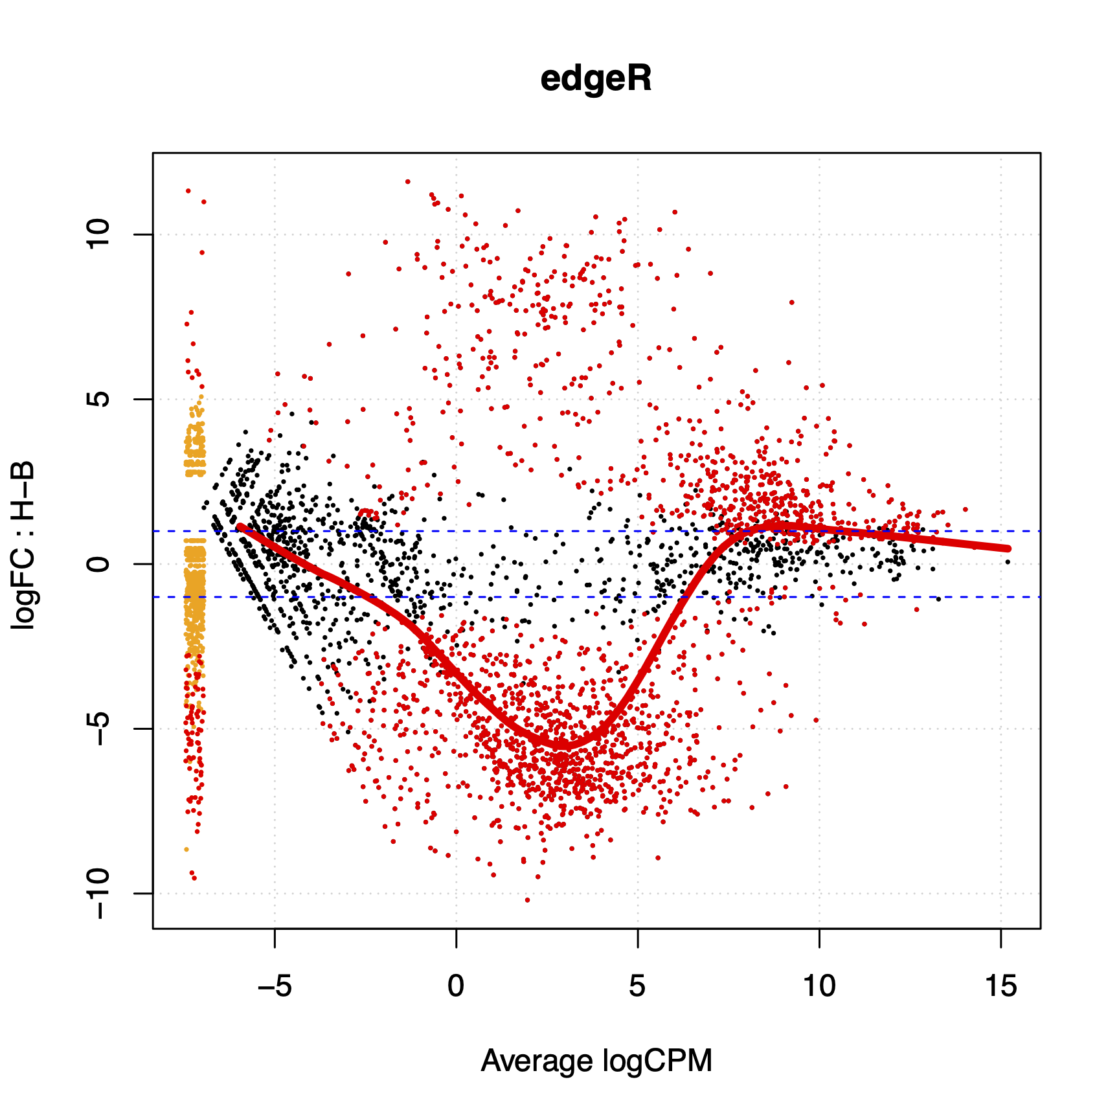
What about my problem?
Scale can be added on a per-group or per-sample basis
Differential scale changes the location of the data
This depends only on the ratio of the scales, not on the value of the scales
Yes, the normalization value is irrelevant but the ratio between the values for different groups is important

Slide 42
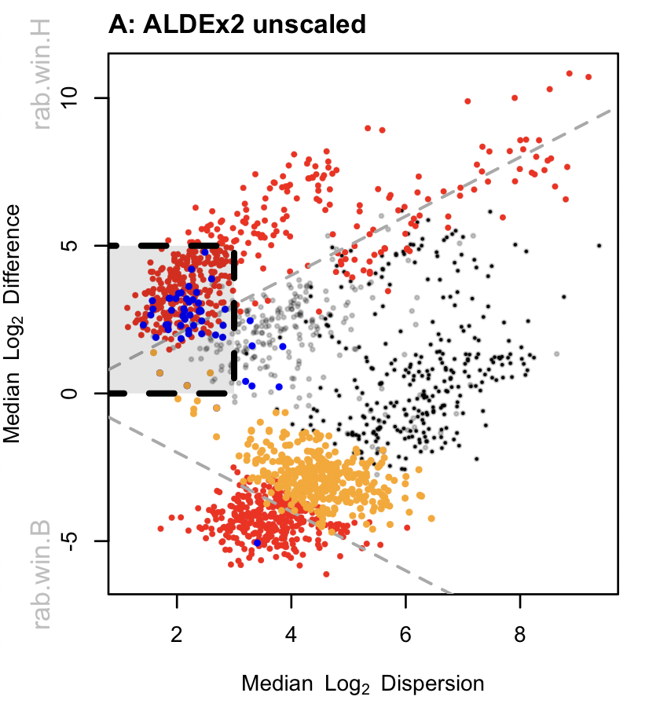
Meta-transcriptomes …
Effect plot
Bit of a mess
Housekeeping genes not centered
HK FP boxed (rRNA, Tsc’n, Gly …)
False negatives not significant
Gamma=NULL

Slide 43
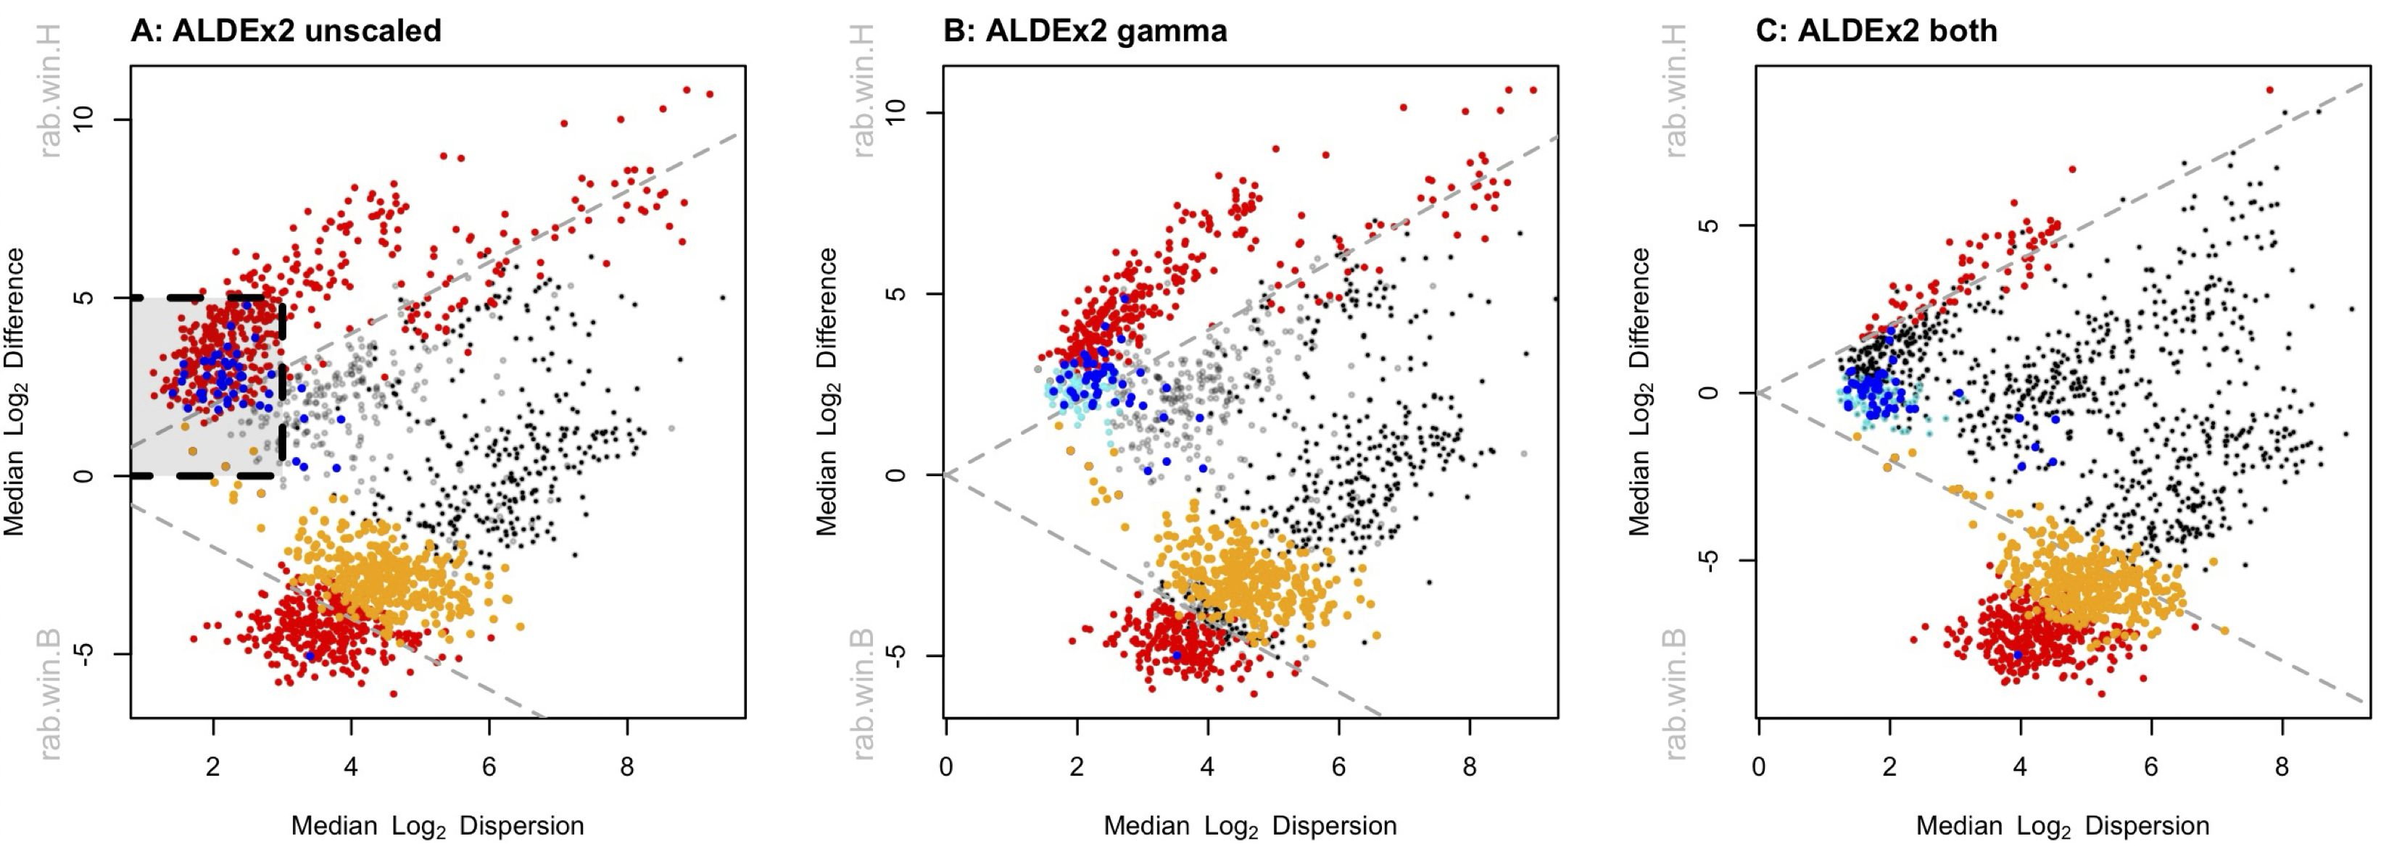
Meta-transcriptomes …
Gamma=NULL
Gamma=0.5
Ratio = 1 : 1
Gamma=0.5
Ratio = 1 : 1.15

Slide 44
Meta-transcriptomes …
CAMP resistance
Metabolism stuff
Nitrogen/Amine metabolism
Gamma=0.5
Ratio = 1 : 1.15

